Slide 1


The Report on the European Rural Youth Survey from 20.-30. October 2019
More information about the youth movement: https://bit.ly/31aQaz2

Slide 2

Index
Introduction
Summary of survey results
Results in infograms
Conclusions

Slide 3
INTRODUCTION
A survey was organised within the movement of European Rural Parliament Youth. The results will be used for developing the Youth Declaration at the European Rural Youth Parliament at the beginning of November 2019. It was performed in 16 countries (11 countries from European Union) and 58 participants was engaged. The survey is expressed in the following absolute values or relative values - proportion of respondents answers from the total number, both kinds of evaluation are expressed in brackets.
A Google forms were used for the survey and a questionnaire was divided into 6 sections with structured questions:
Basic information
Availability and quality of public services
Infrastructure broadband (mobile, internet) and transportation
The variety of opportunities for economic activity
Sustainable agriculture and food production
Civic engagement and political awareness
The section "G. Share your opinion" was semi-structured and longer answers were provided.

Slide 4
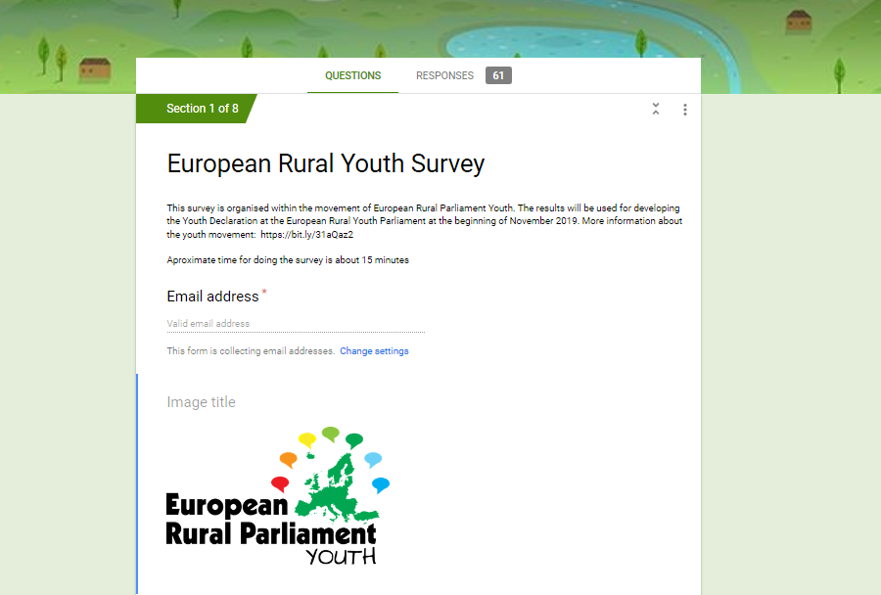
SUMMARY
OF SURVEY RESULTS

Slide 5
SUMMARY OF SURVEY RESULTS
Basic information
In the survey, prevail participants representing two age groups: 21-25 (16) and 26-30 (30). Generally prevailed employed young people (52%) working in non-governmental organisations (NGOs) (43%). Prevailing portion of participants came from villages (71%). The portion of participants working and living towns and in villages was equal but prevailing part of participants (51%) expressed their interest to live in the countryside. Prevailing number of participants worked in the field of rural development (28) and agriculture (18).

Slide 6
SUMMARY OF SURVEY RESULTS
B. Availability and quality of public services
Generally, places (towns, villages, other) where communities live have basic services like shops (47), schools (46), pub and coffee (44), kindergarten (39), sports field (38) while other services other services were present in less than half of the responses. Nearly two thirds of responds (68%) assumed that rental housing was present in their communities. More that half of respondents answered that available services in their communities were: water treatment (20) and quality mobile signal (44), waste water treatment and sewage (33). The most demanded services in the community were educational and healthcare services (6), youth centre (4), public transport, coffee and pub and sport facilities (3) and availability and quality of services was assessed as medium (24).
C. Infrastructure broadband (mobile, internet) and transportation
Connection with the nearest town / city was evaluated to be an appropriate (81%) and public transport is available also during weekend (60%) while the quality of transportation in the community was assessed to be medium (21). Quality of mobile signal and internet connection respondents assessed to be mainly medium (17) and good or very good (15).

Slide 7
SUMMARY OF SURVEY RESULTS
D. The variety of opportunities for economic activity
It is possible to find a job but with difficulties in communities (71%) and prevailing part of respondents believe to establish a self-employment in their communities (66 %). The best mentors helping or providing advisory serviced are assumed by responds to be friends (37), parents (34) or local action groups (LAG) (24).
A self-employment business could be started with financial support; prevailing part of respondents considered grant for seed money (27). On contrary that, comparable portion of respondents (20) does not believe to receive any financial add.
E. Sustainable agriculture and food production
The highest potential for the business development was suggested to be a tourism (14) and agriculture (10) what corresponds with findings that in prevailing respondents villages were located farms (84%), mainly integrating plant and animal production (37) and prevailed farms with organic products (59%). More than half or respondents use to buy organic products (58%).

Slide 8
SUMMARY OF SURVEY RESULTS
F. Civic engagement and political awareness
Prevailing communities have civic associations (69%) but number of respondents working in these civic associations was nearly equal (47%) to number of respondents who did not work here (53%). Prevailing part of respondents participate in elections (85%) but in decision making processes in municipality took use to take a part only 40% of respondents. The needs of youth and young families have official representants in the municipality council in less than half of respondents (38%).
Many respondents (76%) answered to participated in EU projects.

Slide 9
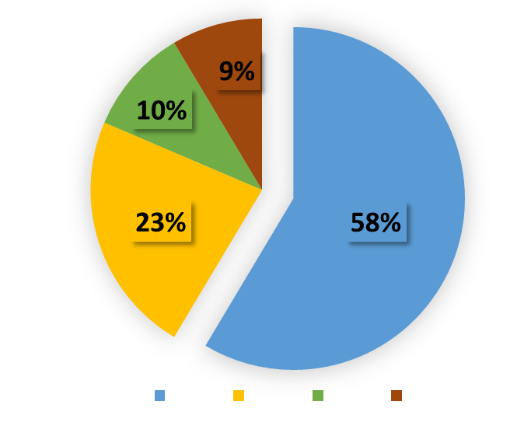
Results in infograms

Slide 10
A. BASIC INFORMATION
Respondents‘ countries
European Union
Other countries

Slide 11
A. BASIC INFORMATION
Age groups of respondents

Slide 12
A. BASIC INFORMATION
Occupation

Slide 13
A. BASIC INFORMATION
Working sector

Slide 14
A. BASIC INFORMATION
Working place

Slide 15
A. BASIC INFORMATION
Field of work / studies

Slide 16
A. BASIC INFORMATION
Where are you from?

Slide 17
A. BASIC INFORMATION
Where do you plan to live in future?

Slide 18
B. AVAILABILITY AND QUALITY OF PUBLIC SERVICES
Public services in community

Slide 19
B. AVAILABILITY AND QUALITY OF PUBLIC SERVICES
Is in your community able to get rental housing?

Slide 20
B. AVAILABILITY AND QUALITY OF PUBLIC SERVICES
What services do you miss most in your community?

Slide 21
B. AVAILABILITY AND QUALITY OF PUBLIC SERVICES
The quality of mobile service and internet availability in your community:

Slide 22
C. INFRASTRUCTURE BROADBAND (MOBILE, INTERNET)
AND TRANSPORTATION
In your comumunity is available:

Slide 23
C. INFRASTRUCTURE BROADBAND (MOBILE, INTERNET)
AND TRANSPORTATION
Can you get to the closest city / town by public transport / neighbours when is needed?

Slide 24
C. INFRASTRUCTURE BROADBAND (MOBILE, INTERNET)
AND TRANSPORTATION
Is there public transport available on weekends and days off?

Slide 25
C. INFRASTRUCTURE BROADBAND (MOBILE, INTERNET)
AND TRANSPORTATION
The quality of mobile service and internet availability in your community:

Slide 26
C. INFRASTRUCTURE BROADBAND (MOBILE, INTERNET)
AND TRANSPORTATION
The quality of mobility/transportation opportunities in your community:

Slide 27
D. THE VARIETY OF OPPORTUNITIES FOR ECONOMIC ACTIVITY
Is it possible to find a job as emoplyee in your community?

Slide 28
D. THE VARIETY OF OPPORTUNITIES FOR ECONOMIC ACTIVITY
Could you imagine that you would be self-employed in your community?

Slide 29
D. THE VARIETY OF OPPORTUNITIES FOR ECONOMIC ACTIVITY
Who would you ask mentor support in your community for finding job or establishing your business?

Slide 30
D. THE VARIETY OF OPPORTUNITIES FOR ECONOMIC ACTIVITY
Are there any support systems for starting business for young people?

Slide 31
D. THE VARIETY OF OPPORTUNITIES FOR ECONOMIC ACTIVITY
What potential development of economy is in your community?

Slide 32
E. SUSTAINABLE AGRICULTURE AND FOOD PRODUCTION
Is there a farm in your village?
Kind of farm:

Slide 33
E. SUSTAINABLE AGRICULTURE AND FOOD PRODUCTION
Is the farm producing organic products?
Do you buy products from the farmer?

Slide 34
F. CIVIC ENGAGEMENT AND POLITICAL AWARENESS
Is there located a civic association / NGO in your community?
Do you belong into this assocation / NGO?

Slide 35
F. CIVIC ENGAGEMENT AND POLITICAL AWARENESS
Do you participate in elections?
Do you participate in the local decision making / municipal council?

Slide 36
F. CIVIC ENGAGEMENT AND POLITICAL AWARENESS
Do you have in the village committee or youth worker who work to the needs of young people or young families?

Slide 37
F. CIVIC ENGAGEMENT AND POLITICAL AWARENESS
Have you participated in any EU supported project?

Slide 38
G. SHARE YOUR OPINION ON
It is semi-structured part of the survey.
After each question a short evaluation of answers is provided in diagrams emphasising the main – lightmotive/s of answers (symbol of a star) and directly related topics (clouds). Other topics which have partial relation or do not have any relations to each other are displayed in green and grey squares.
Number of answers includes only different ones. Analogical or even the same answers were joined together into one point.

Slide 39
G. SHARE YOUR OPINION ON
1. Do you think that there is any discrimination of women in your region to set up their own business or find a job?
Can you explain the discrimination? (11 different answers)
People still think of women as more depending on the others than men are, that includes career building as well, patriarchal society found
Salary/wage
This is not a direct discrimination, but rather a tacit one. If a family has kids, most probably it will be the woman who will choose/will have to work part-time or during traditional office hours to be able to take care of the kids when they are not in school/kindergarten. Also, the best paying jobs in the village are usually done in shifts and require a set of skills (including technical skills and physical strength) usually owned by a man while all the care-taking jobs that can also be physically demanding (like working with sick and disabled elderly people), but do not involve being able to manipulate machinery, pay just the bare minimum. This is not to say that a woman could never do those technical jobs, there are the exceptions, it is just that from what I've seen a man will be the first choice as women are considered incompetent by nature in all matters technical and logical, at least in this community. So, I do not see most women being comfortable pursuing such a career. I would really be happy to be proven wrong on this.
I think the is a sense of exclusion of women from business activities which is assimilated also by women themselves. More importantly, young women work in business and are those who do not benefit from. They provide a valuable support, but men earn the profit. It´s not a clear one but the environment makes it indirectly more difficult. Usually the minds about women in the farming and rural environment are not that open or advanced.
It is traditional opinion of population at mine community. Women are housewives and men difficult adopt that woman can be useful in business. Men are often non-cultural to the women and they often flirting (they are not professional with the women college in job). Usually word is "you can't do it".
Insufficient infrastructures, badness to service
Unequal treatment and access to guaranteed rights because of certain aspects that differentiate you from others.
The first problem is that they could not find help for financial funds also opportunity for training to gain their knowledge.
There is no discrimination against women
Stereotypes
Family duties to care for children first

Slide 40
G. SHARE YOUR OPINION ON
Can you explain the discrimination?
patriarchal society
stereotyps:
woman = family and children care
no equal role of women and men in society
better paid jobs for men than for women
unequal rights, treatment, weak funding support
salary
bad services
no discrimination against women

Slide 41
G. SHARE YOUR OPINION ON
2. Do you feel discrimination in certain situations just because you are based in rural area (like limited access to your requirements, needs, etc.)? (30 different responses)
No
Not in my case because I live in city, but I see some rural communities which have difficulties regarding transport communication or even if they want to go to main supermarkets (oil costs, transport). There are some problems with Internet too.
Without a car, you can not efficiently go to work, tp the supermarkets, to sports or to leisure activities
Sometimes
Not really because the area where I come from is not that isolated like some other parts of region/country
Sometimes you have to go to the nearest city to get specific services.
yes, but this problem is in cities too
sometimes
My grandparents live in village. I live in city. But, people that live in village here have limited access to internet, civil society activities and that needs to be changed.
Yes. When it comes to art, music, festival, fun.
Yes. As I am self-employed i need to buy supplies and materials which are not available in my town.
limited internet access, public transport, employment opportunities and free time
Maybe and probably. It´s always a little bit more difficult for communications and always having to move among other aspects.
Yes, one of my NGO's are located near to the sea and that makes some things different and difficult, and also a lot of rich people have their houses there
Yes - poor broadband and public transport hinder development in our village. Towns are better, but still far removed from the centre of power
Yes limited access to career progression.. Less opportunity for career advancement.. Will need to move to city for better paid jobs and promotions in my sector
yes, access to certain health care opportunities
Yes, limited resources
Yes because of transportation. We have no water supply and no pubblic transportation
Yes. The city-dwellers constantly (both in private and publicly) refer to the rural population as less-than people and thus justify the hardships that are common in rural areas like school and medicine quality and accessibility, infrastructure quality, lower wages than in the city etc. One such instance would be nothing, but it is a recurring pattern where city based and well off economists and politicians etc. believe they are qualified to speak about rural life just because they have numbers and stats. But they never cite any anthropology or sociological study. The signals we get from this kind of arrogance are that rural communities are not needed. At all. Just a few large scale farms and natural resource companies operated by a selected crew and automatization should stay there, but the rest of it should move to cities at once and be done with it. I get a feeling that they consider such scenario an ideal and efficient one and therefore make decisions and issue legislation that create incentives (sticks, not carrots) for rural population to transfer to cities as soon as possible or else face additional expenses, taxes and limitations.
I felt when I was younger. But now, though is difficult, I don't feel because I have more self-confidence and I love nature.
Yes.
yes for access to public transport and for all convenience
Not necessarily discrimination in full sense of the word, but a kind of a unfair level playing field compared to those living in urban areas. However, I find it reasonable that due to financial reasons not all rural areas can have entire sets of services that would make citizens' lives easier.
Yes, little bit.
Discrimination refers to the ability to travel to big centers to find a job.
No, because rural is rural town is town, is 2 different places and something what is possible in rural is not possible in town and vice versa.
No, I can not feel it.
Not sure.
Somehow yes; lack of references is a problem. City dwellers have more networks.

Slide 42
G. SHARE YOUR OPINION ON
Do you feel discrimination in certain situations just because you are based in rural area ?
bad services
internet
difficult access to services , bad infrastructure
cultural events
ignorance of rural problems by decission makers at national level
limited career progress
roads
shops
services, material
isolation
lack of jobs in villages
no discrimination

Slide 43
G. SHARE YOUR OPINION ON
4. What is the main factor which helps in providing, usability improve services and infrastructure in rural areas?
(33 different answers)
Maybe all the help by our eleven Local Action Groups, they are always open-minded to listen people and communities requirement in order to help them, and provide grants to support their local initiatives.
There are still transportation for pupils to go to schools. But after this, there is nothing.
Finance, money, support and smart planning, public and private investment
A fair market
Long term thinking, new technologies, EU funds.
EU funds, making the countryside more attractive - for businesses and living
Support to youth.
In Bosnia and Herzegovina donations from European Union, USAID and other organizations.
Improvements in technology and accessibility of technological advances, as well as networking of services in rural areas with those in urban areas, digitalization, youth return to rural areas, availability of digital services, better broadband on digital connectivity, digital connection
The agricultural factor with temporary employment
Communications and a lack of people involved in improving it
Smart planning. Getting the infrastructure in the communication in order and being active in supporting local businesses. If there are roads, people and businesses can reach whoever they need. If there are satisfying and decently paid jobs, people feel more inclined to live here. If people live there long term, they have kids and society can grow, the governmental services get a decent use, shops and other businesses have customers and are not shut down. So, roads and attitude first.
Young or older actors who are able to start with some new project or activity. In last two years we have a good leader (the mayor) who wants to develop rural areas.
Humans
Create jobs to create conditions for rural tourism
I do not know
Personal transport
Training and better knowledge of diversification of activities
Availability of all resources (ptt, internet, social capital, water resources) which can be applied in rural areas
Solve the problem and find a way by making different innovative products
Friendly people, good Teams and working groups. Information for people, they have to know all information about options in their areas.
Building new job places in rural areas which will cause migrations from towns to village.
Contacts, support from municipality
Scale economies, optimisation
Mobile service, roads and water supply
Rising population
Local tax
Interest
Better prices
Transport and infrastructure
Active citizens
To know community needs; fund accessibility
People who are ready to take action

Slide 44
G. SHARE YOUR OPINION ON
What is the main factor which helps in providing, usability improve services and infrastructure in rural areas?
knowledge on funds
available and fast internet
improving communication
good relations with municipality
availability of information technologies
rising population
EU funds, active citizens, local action groups
smart planning
public transport
fair market
rural tourism support
making innovative products
local taxes
temporary emplyment in agriculture
youth support
no discrimination

Slide 45
G. SHARE YOUR OPINION ON
5. Do you know any inspiring rural youth initiatives? If yes, can you shortly describe it? (18 different answers)
No, none that I can think of, not in your community
Rural Youth Block (https://twitter.com/bloque_joven?lang=es) / ESN Oviedo (https://www.esnoviedo.org/news/welcome-erasmus)
Common rooms or houses where different activities are offered and people can meet.
Rural Parliament, School of Permaculture, Živica
Producing honey from regions covering all the northern valleys. And he is advocating to create a brand and commercialize the product.
I am not sure if it is a youth initiative and I cannot recall the name. However, I know that each year, in Finland, there is a community of artists meeting in a well organised venue for developing projects related to painting, singing, IT tools, theatre, etc.
Granting university students and making it publicly; forming Facebook groups about it
Yes. There was a bar opened recently and the owners are young people. This is in the closest city, but nevertheless there was no such place before, nowhere close to us at least and not only it offers drinks and a col space to socialize in the evenings, but also invites speakers, organises table game evenings and live music evenings, exhibitions etc. A very, very needed place.
In mine local community we have Non-formal group of youth called "Association of youth Tupković" where we develop social and economic status of local community. For example we take care about nature of community, organize educations and hangings and also we organize humanitarian helps. Also, there is some others NGO organizations like: Foundation of Tuzla community, Red cross, association "Youth", squad of scouts "Krin Tuzla", etc..
In my city it is planned to adopt a strategy for the development of young people in the coming period
Yes, it is Dolina village initiative. Young people from this village have started it. They have an old building, so they made project, applied at IOM and got money for renovate it. Now it is youth community centre.
Yes, I do. I created a Youth Association in order to teach young people what was our cultural heritage.
tarlamvar.com
Almost none, very little effort to make something happen in rural communities
Volim Beli is an NGO that focuses on young and organises activities for children and young families during the whole year
The mosaic of opportunities. Companies, associations and youth organize together the choices of future experiences... And this flexible ecosystem allows options to youth in their pathways..
Macra na feirme. Rural youth club to promote social events
Lišov Museum

Slide 46
G. SHARE YOUR OPINION ON
Do you know any inspiring rural youth initiatives? If yes, can you shortly describe it?
educational services, advocacing in bussines activities
honey production
a place where to discuss public affairs or enjoy music e.g.
youth associations, civic organisation
School of Permaculture
Foundation of Tuzla community, Red cross, association "Youth", squad of scouts "Krin Tuzla
Rural Parliament
making initiatives to be public
Dolina village innitiative
Lišov Museum
youth support
tarlamvar.com
Živica
Volim Beli
Association of youth Tupković
no doe not exist any innitiative
Macra na feirme

Slide 47
Conclusions
The survey refers mainly to opinions of young respondents from European Union who came from villages, live and work in the rural environment and who are employed predominantly in non-governmental organisations. Many respondents have experiences with active citizenship what makes the results trustworthy. Outcomes rooted in real experiences.
Generally, basic services missing and infrastructure is week in the countryside. Therefore, there have been persisted social-economic problems: difficulties with the job approaching to towns, access to material for business activities or services. Slow or missing internet connection limits the development of innovative activities and almost all business activities.
It is possible to be employed in a village and a self-employment plays an essential role here. Basic servises are usually present in villages (drinking water, sewage ..). However, services improving the life quality are rarely present. The best advisory services can provide friends, parents and local action groups. Solving problems during the business establishment help grant subsidies.

Slide 48
Conclusions
The highest potential for business development is foreseen in tourism and agricultural sector in the countryside. Respondents positively reacted on the presence of farms, particularly organic farms in their villages and usually prevailing portion of respondents supports producers by buying local or regional organic products in their communities.
Surprising was that besides prevailing part of participants work in non-governmental organisation they do not use to be engaged in decision making processes in their municipality. On the other hand, these respondents use to take apart at the national elections while a local level has remained unnoticed.
Positive is that an interest of youth to solve the projects of European union is increasing.

Slide 49
Conclusions
Generally, discrimination of women was reported only circa in one third of answers. The discrimination was related mainly to unequal roles of women and men in society what mirrors mainly in adequate jobs of women where they could reach similar salaries as men.
The most of problems (lack of relevant jobs, weak infrastructures and bad services...) roots in ignorance of rural specifics by decision-makers at the national level. The reluctance of competent bodies limits also spreading of new technologies and internet in the countryside what negatively influences almost all current business sectors in villages.
Better availability of internet would be beneficial for smart planning, creating innovative products etc.
An important role have non-governmental organisations and active citizens who activate competent bodies, co-operate on EU grants and bring money from funds to common rural life. Further, provide support for youth in the villages (places to meet, to have a festival etc.) and they help to transfer youth opinions to the wide public.

Slide 50
More information about the youth movement: https://bit.ly/31aQaz2

